Slide 1
Understanding Air Pollution in India
Name:JEGATHEEP KANNAN. J
College: St. peter’s college of engineering & technology
Dept: Civil Engineering

Slide 2
Introduction to Air Pollution:
Air pollution refers to the presence of harmful substances in the air that can pose risks to human health, ecosystems, and the environment. In India, air pollution has become a significant environmental and public health concern, particularly in urban areas and industrial regions. Major air pollutants include particulate matter (PM2.5 and PM10), nitrogen dioxide (NO2), sulfur dioxide (SO2), carbon monoxide (CO), ozone (O3), and volatile organic compounds (VOCs).

Slide 3
Objective of Analysis:
The objective of the analysis is to gain a comprehensive understanding of the current state of air pollution in India. This involves examining available data, identifying trends and patterns in air quality, assessing the impact of air pollution on various sectors, and exploring potential mitigation strategies. By analyzing air pollution data, we aim to inform decision-making, raise awareness, and drive action towards improving air quality and protecting public health.

Slide 4
Data Collection:
Air pollution data in India is collected by various government agencies, research institutions, and non-governmental organizations (NGOs). This data includes measurements of air pollutant concentrations at monitoring stations located across different cities and regions. The dataset used for analysis is typically obtained from publicly available sources and undergoes preprocessing steps such as cleaning, filtering, and organizing to ensure data quality and reliability.

Slide 5
Exploratory Data Analysis (EDA):
Exploratory Data Analysis involves an initial exploration of the dataset to understand its structure, characteristics, and distribution of air pollutants. This includes calculating summary statistics, visualizing data using charts and graphs, and identifying any anomalies or patterns that may warrant further investigation.

Slide 6
Impact Assessment:
Impact Assessment evaluates the health, economic, and environmental impacts of air pollution on society and ecosystems. This includes quantifying the health effects of exposure to air pollutants, estimating economic costs associated with healthcare expenses and productivity losses, and assessing environmental impacts such as ecosystem damage and climate change.

Slide 7
Mitigation Strategies:
Mitigation Strategies aim to reduce air pollution and promote clean air through various policy measures, technological solutions, and community initiatives. This includes implementing regulatory frameworks, adopting cleaner technologies, promoting renewable energy sources, and raising public awareness about the importance of air quality and sustainable living practices.

Slide 8
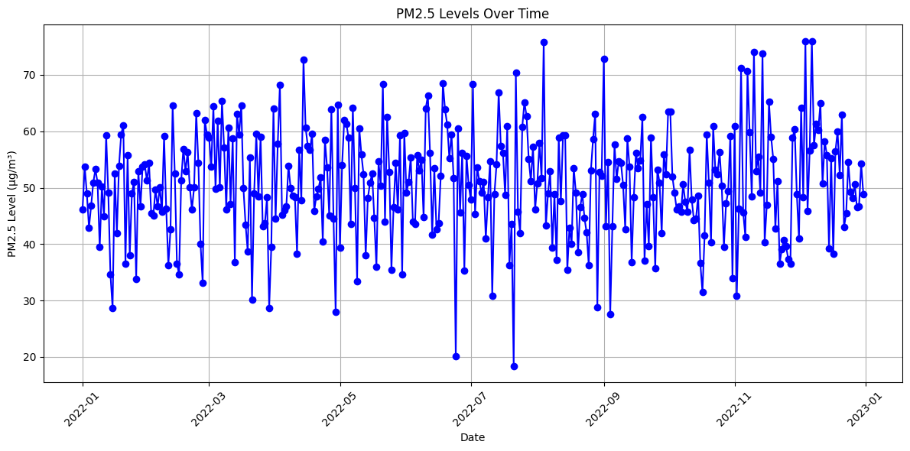
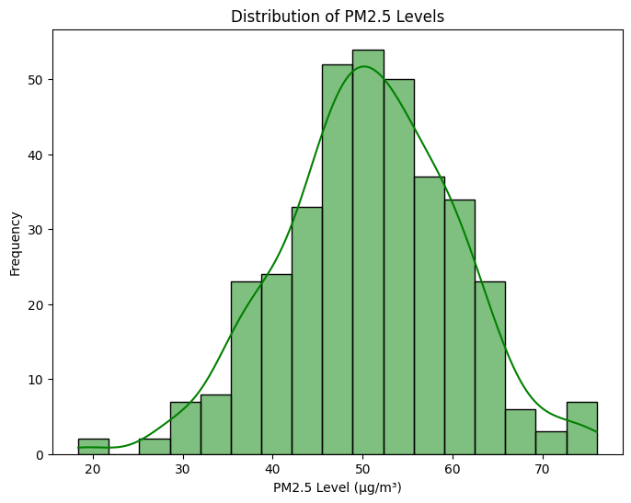
Result :

Slide 9
Conclusion:
In conclusion, the analysis of air pollution in India provides valuable insights into the state of air quality, its impact on public health and the environment, and the need for concerted efforts to address the air pollution crisis. By understanding the causes and consequences of air pollution and implementing effective mitigation strategies, we can work towards achieving cleaner and healthier air for all citizens.

Slide 10
THANK YOU

